Slide 1
AgriLife Presentation Template
Name of Presenter
Title Line 1 Title Line 2

Slide 2
Read Me First!
Make a copy of this template
Save this Template somewhere handy. Make a copy of this presentation when you are ready to make it yours.
Read through the template first!
This template includes slide variations as well as tips for you to create your best presentations!
Stick to the brand
Use the embedded brand fonts and colors throughout your presentation for best results.

Slide 3
Using Layout View

Slide 4
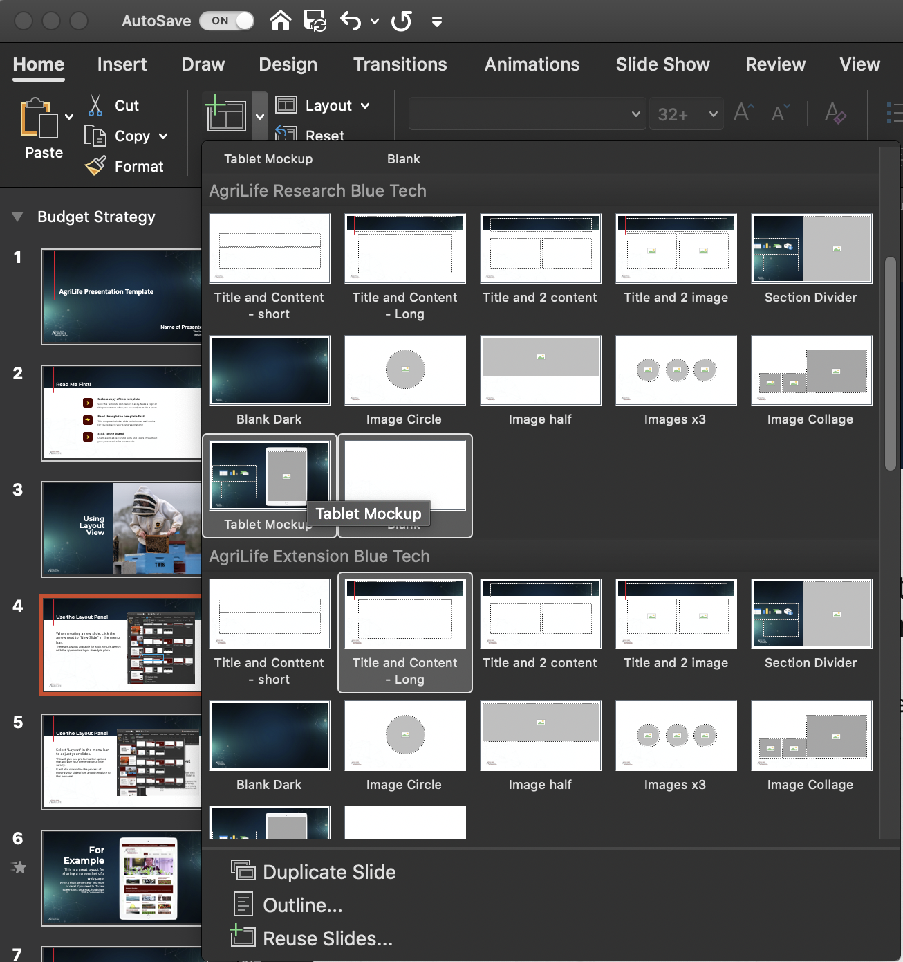
Use the Layout Panel
When creating a new slide, click the arrow next to “New Slide” in the menu bar.
There are Layouts available for each AgriLife agency, with the appropriate logos already in place.

Slide 5
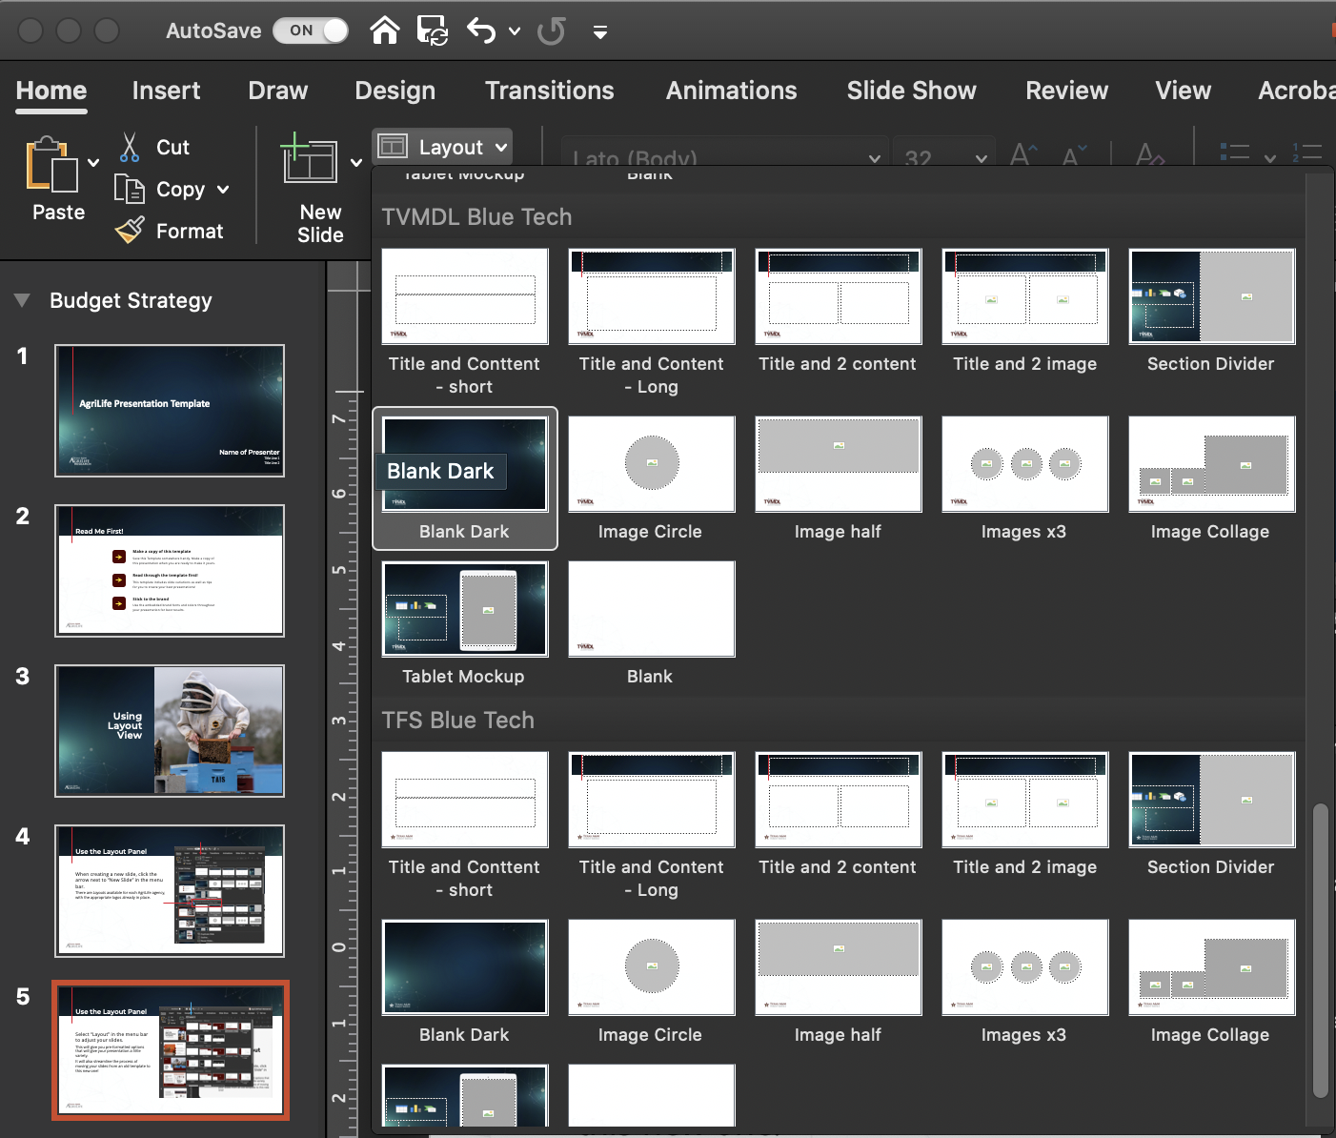
Use the Layout Panel
Select “Layout” in the menu bar to adjust your slides.
This will give you pre-formatted options that will give your presentation a little variety.
It will also streamline the process of moving your slides from an old template to this new one!

Slide 6
For Example
This is a great layout for sharing a screenshot of a web page.
Write a short sentence or two more of detail if you need to. To take screenshots on a Mac, hold down Shift+Command+4

Slide 7
This is a great layout for a lot of content

Slide 8
Or for an infographic
Time Line Example
Date
Time Line Example
Date
Time Line Example
Date
March
April
May
June
July
August
Time Line Example
Date
Time Line Example
Date

Slide 9
DISCUSSION

